Slide 1
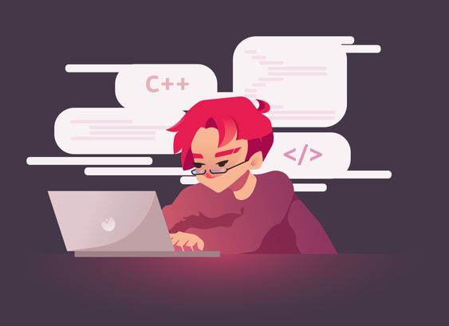
C++ L01
Writing our first program!

Slide 2
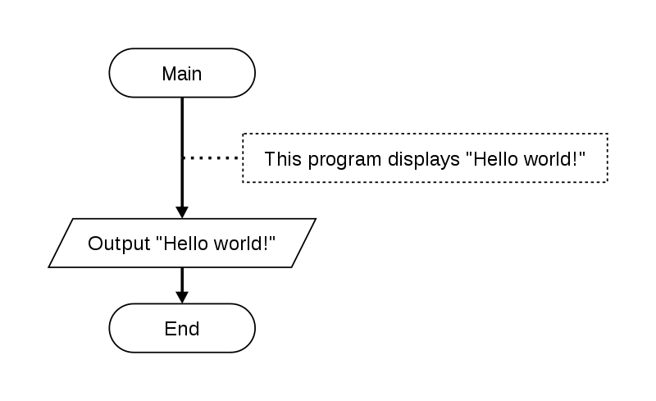
PSEUDOCODES

Slide 3
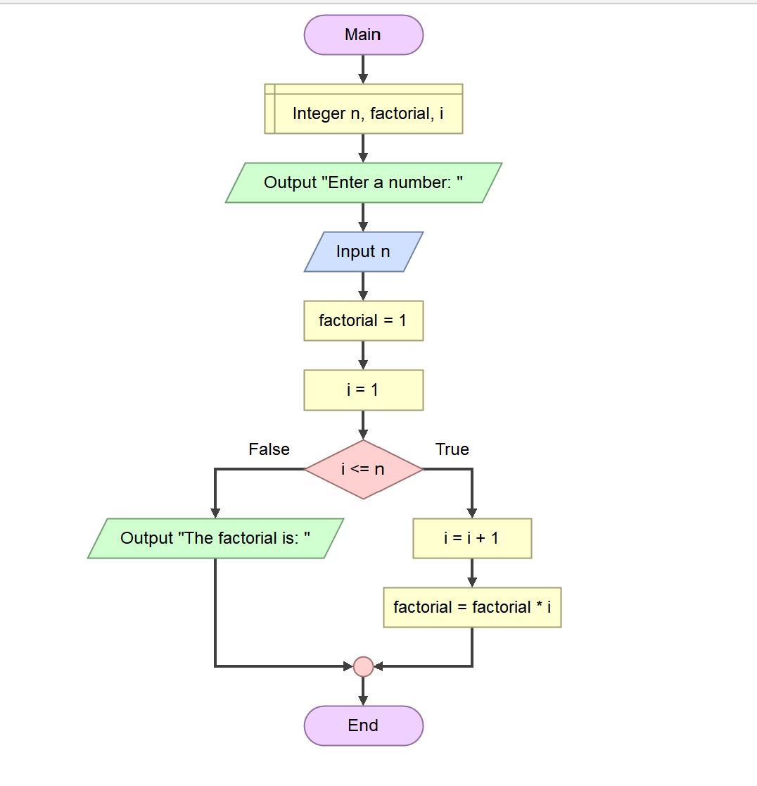
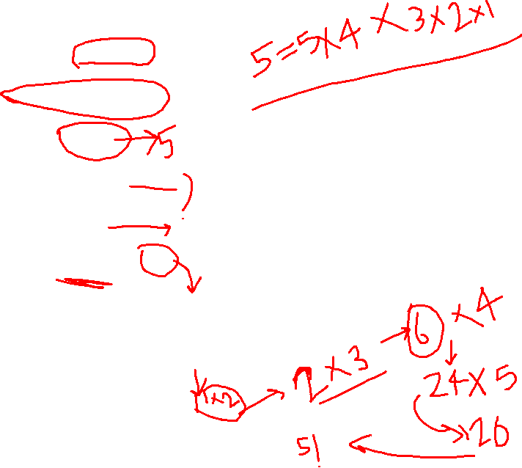

Slide 4
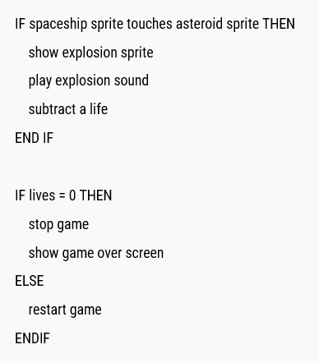
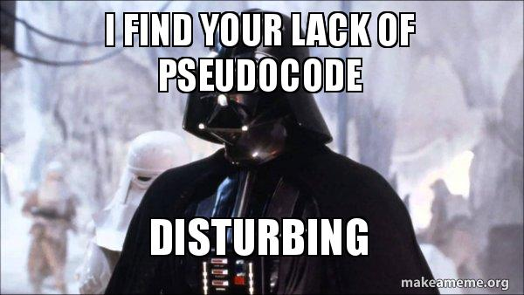
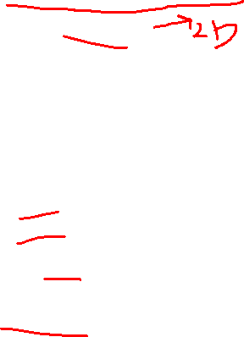
Pseudocode for a factorial

Slide 5
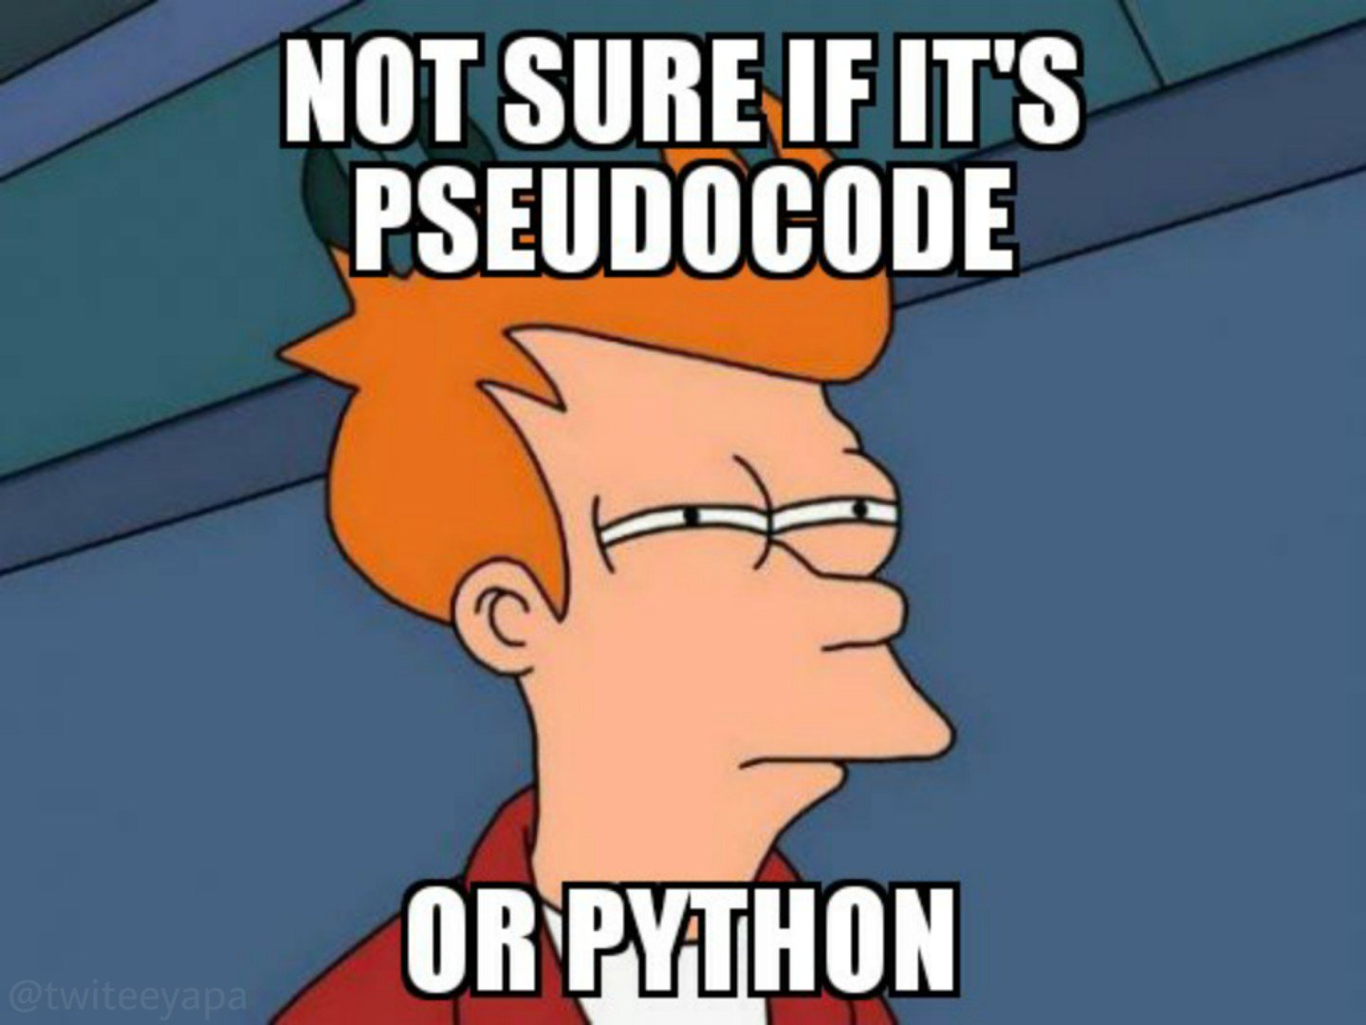

Slide 6
homework
Write a pseudocode to print numbers from 1 to 10.
Write pseudocode to print if the integer which the user input is prime or not prime.
Write a pseudocode to print sum of n(integer which the user input) numbers starting from 1 to n.

Slide 7
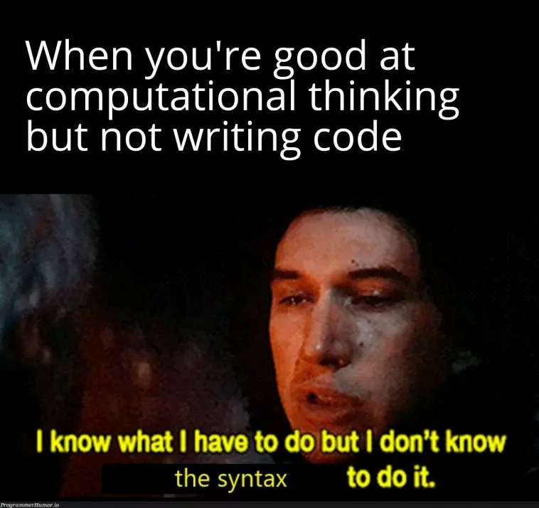

Slide 8
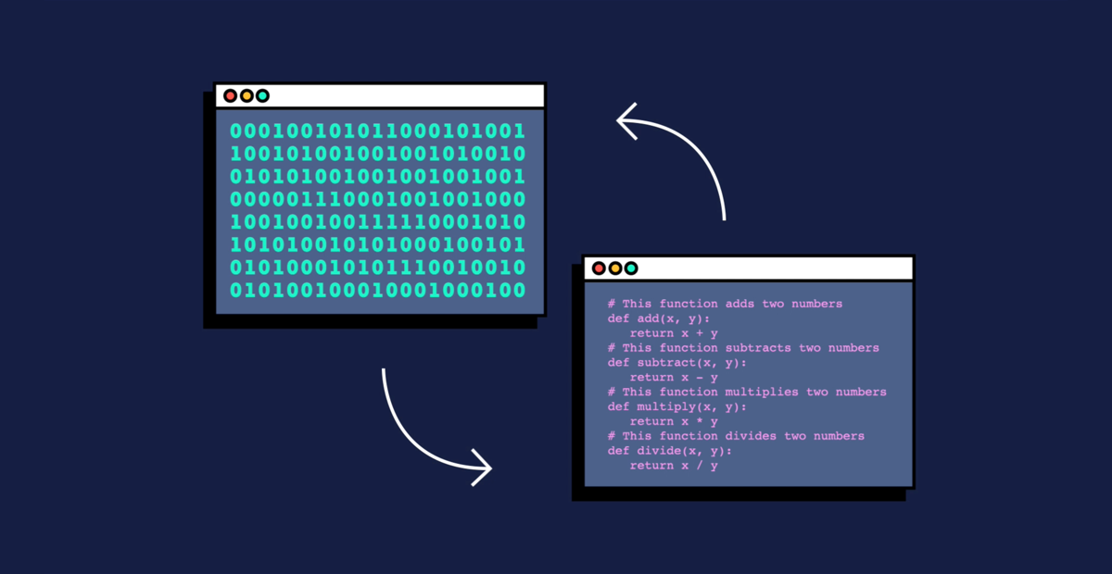
What is programming language?

Slide 9
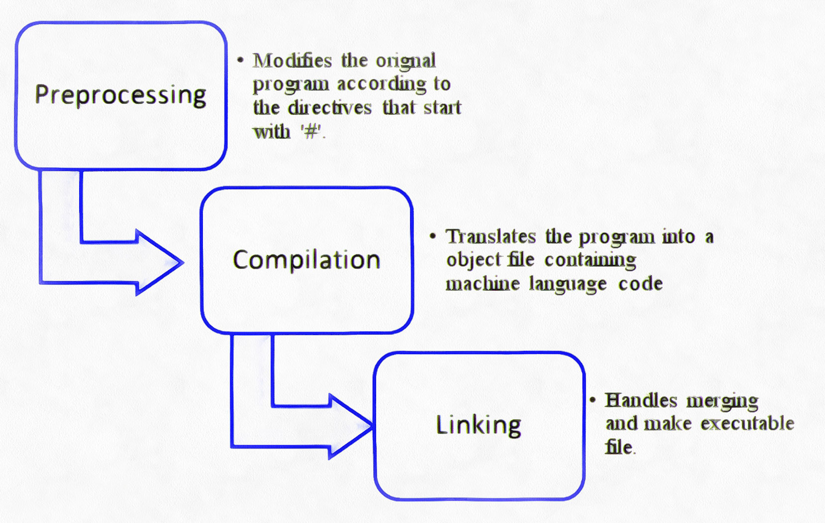
Compilation process in c++

Slide 10
Write your own first program!!
Slido - https://app.sli.do/event/ibNyCP623eGzDRz1G4fu2V

Slide 11
What does “ using namespace std; ” mean?
In C++ programming, the `using namespace std;` statement is used to indicate that you want to use the standard namespace in your program.
The C++ standard library provides a collection of functions and data types that are commonly used in C++ programming. These functions and data types are defined in the `std` namespace to avoid naming conflicts with other libraries and user-defined types and functions.
When you write `using namespace std;`, you are telling the compiler that you want to use the names of the functions and data types in the `std` namespace without having to prefix them with `std::`. For example, instead of writing `std::cout << "Hello, world!" << std::endl;`, you can write `cout << "Hello, world!" << endl;` after including the necessary headers.
It's important to note that using `using namespace std;` can potentially introduce naming conflicts if there are functions or data types in other namespaces with the same name as those in the `std` namespace. To avoid this, some programmers prefer to explicitly prefix the functions and data types with `std::` to make it clear which namespace they are coming from.

Slide 12
Datatypes & variables
A data type is a classification of data that defines the type of value a variable can hold, the operations that can be performed on it, and the memory space required to store it.
A variable is a named storage location in a computer's memory that is used to store a value that can be accessed and modified by a program. Variables can hold different types of data, such as integers, floating-point numbers, characters, strings, and Boolean values.

Slide 13
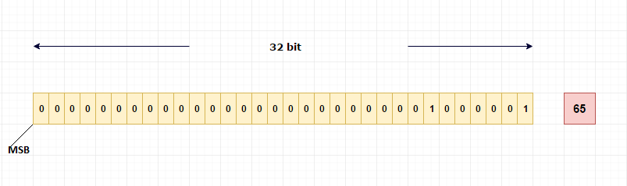
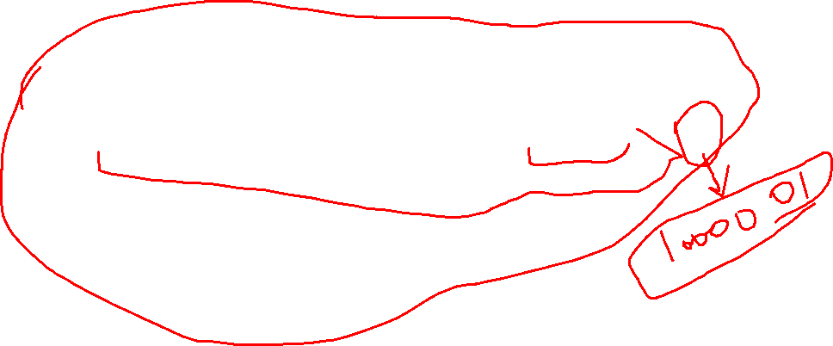
How positive integers are stored in memory?

Slide 14
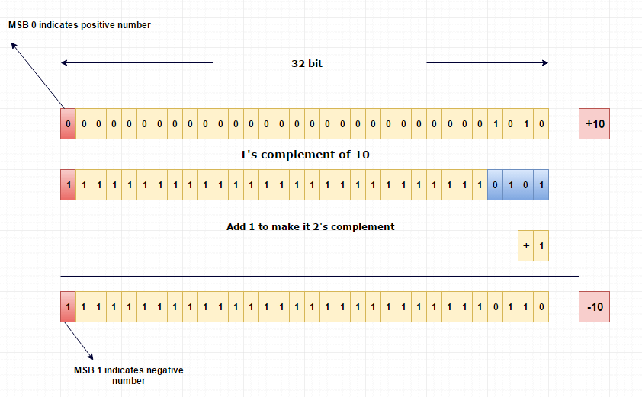
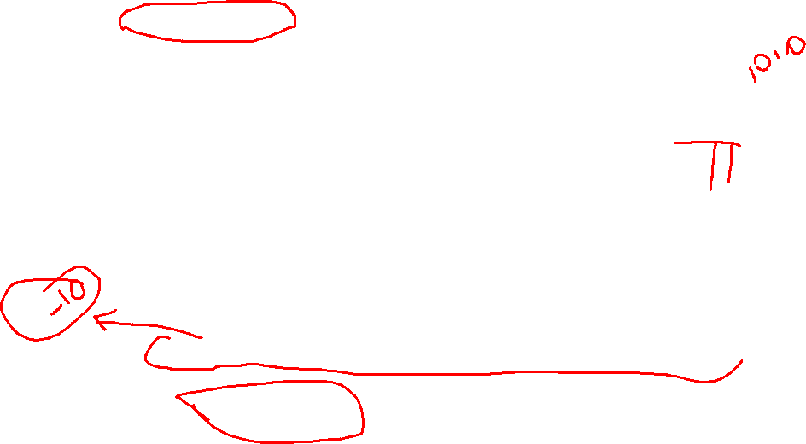
How negative integers are stored in memory?

Slide 15
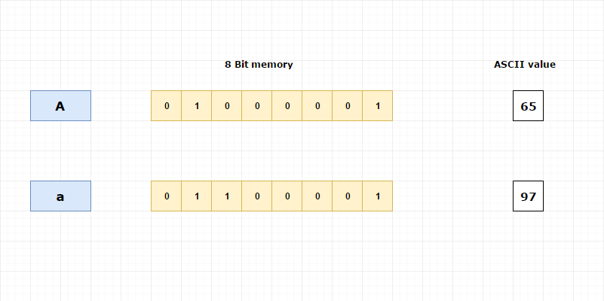
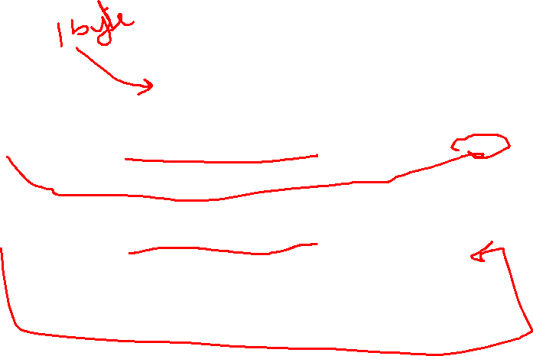
How characters are stored in a memory?

Slide 16
Typecasting
Typecasting, also known as type conversion, is the process of converting a value from one data type to another in C++. Typecasting can be either implicit or explicit.
Implicit typecasting occurs automatically when the compiler converts a value from one data type to another in certain situations. For example, if you assign an integer value to a floating-point variable, the compiler will automatically convert the integer to a floating-point value.
Explicit typecasting, on the other hand, requires the programmer to explicitly specify the conversion using a cast operator.

Slide 17
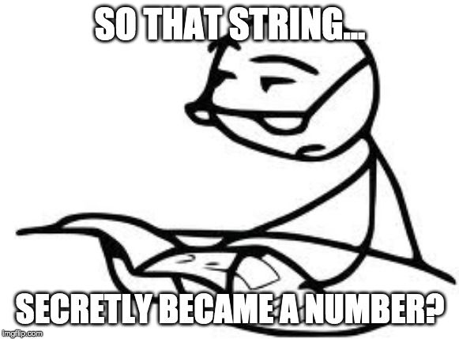
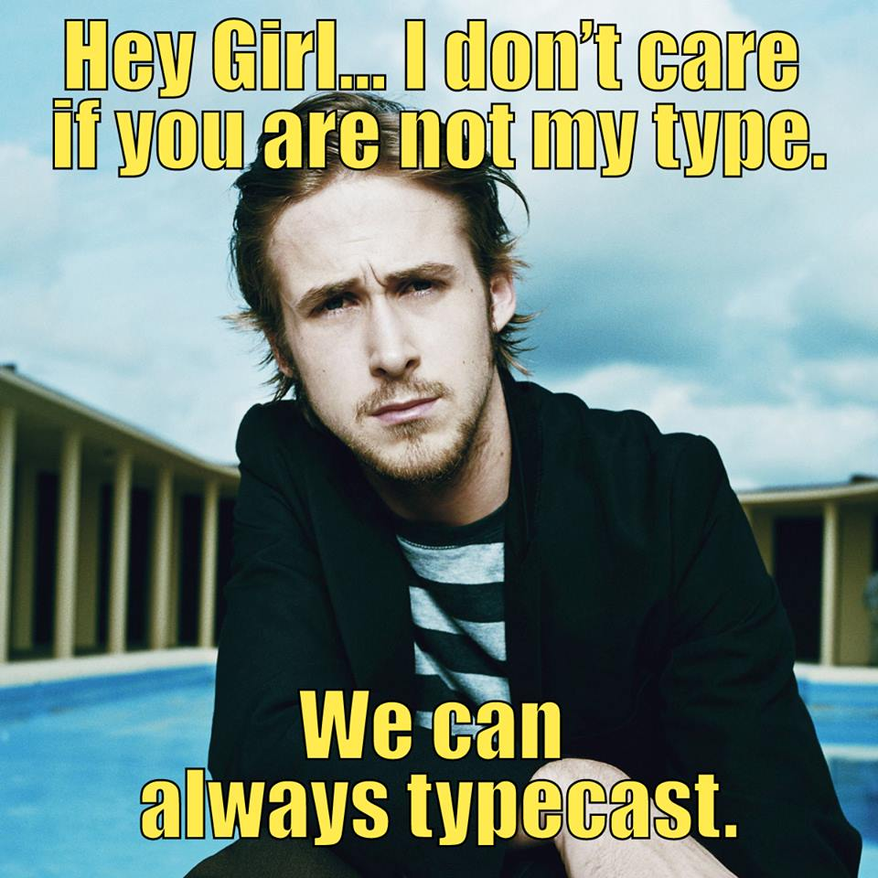
Example of Implicit Type Casting:-
Example of Explicit Type Casting:-

